Slide 1
Lecture 22
Artificial Neural Network
Yaohang Li
Department of Computer Science
ODU
Reading for This Class:
Not in the Book

Slide 2
Review
Last Class
Pattern Recognition
Matlab Neural Network Toolbox
Confusion Matrix
This Class
Learning using Neural Network
Next Class
Uncertainty

Slide 3
Disadvantages of Decision-Tree Learning
Large-Scale Information
A big decision tree
Not efficient
Contradictory information
Fail to build a decision tree
Decision tree is not robust to contradictory or erroneous information
Hard to handle noisy information
Missing Information
Not all the attributed values are known in some given examples
Hard to classify
Adaptability
Learning Decision Tree may not be useful in a changing environment
Real Time Response
If the decision tree is large, response time may be long

Slide 4
Neural Networks
Neural Network
Artificial System
Perform intelligent tasks
Similar to functions of a human brain
complex networks of simple computing elements
capable of learning from examples
with appropriate learning methods
collection of simple elements performs high-level operations
thought
reasoning
consciousness

Slide 5
Advantages of Neural Network
Robustness
Noisy Data
Conflicting Information
Adaptability
Handling Wide Palette of Environment
Unknown
Complex
Dynamical
Real-time response
Inherently parallel

Slide 6
Motion planning with Artificial Intelligence techniques?
Neural navigation systems are based on the way humans react to their environment:
Humans | Neural networks
Experience from observation | Training from examples
Autonomous decisions | Generalization Continuous optimization
Actions | Network simulation

Slide 7
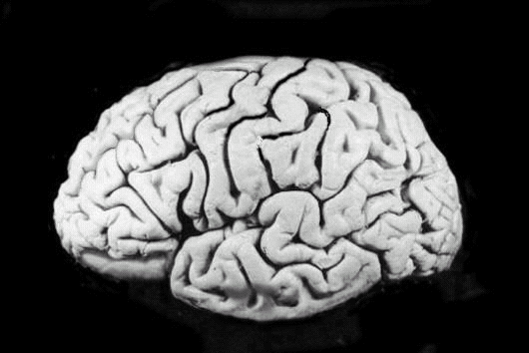
Neural Networks and the Brain
brain
set of interconnected modules
performs information processing operations at various levels
sensory input analysis
memory storage and retrieval
reasoning
feelings
consciousness
neurons
basic computational elements
heavily interconnected with other neurons
[Russell & Norvig, 1995]

Slide 8
Neuron Diagram
soma
cell body
dendrites
incoming branches
axon
outgoing branch
synapse
junction between a dendrite and an axon from another neuron
[Russell & Norvig, 1995]

Slide 9
Computer vs. Brain

Slide 10
Artificial Neuron Diagram
[Russell & Norvig, 1995]
weighted inputs are summed up by the input function
the (nonlinear) activation function calculates the activation value, which determines the output

Slide 11
Common Activation Functions
[Russell & Norvig, 1995]
Step_{t}(x) = 1 if x >= t, else 0
Sign(x) = +1 if x >= 0, else –1
Sigmoid(x) = 1/(1+e^{-x})

Slide 12
Neural Networks and Logic Gates
[Russell & Norvig, 1995]
simple neurons with can act as logic gates
appropriate choice of activation function, threshold, and weights
step function as activation function

Slide 13
Network Structures
in principle, networks can be arbitrarily connected
occasionally done to represent specific structures
semantic networks
logical sentences
makes learning rather difficult
layered structures
networks are arranged into layers
interconnections mostly between two layers
some networks may have feedback connections

Slide 14
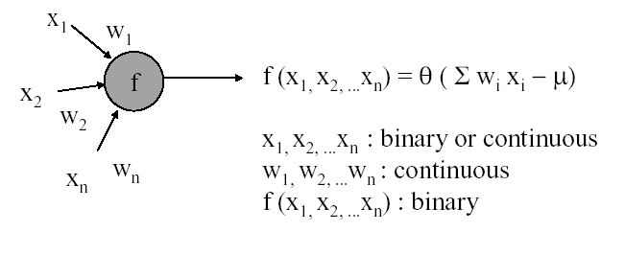
Perceptrons
single layer, feed-forward network
historically one of the first types of neural networks
late 1950s
the output is calculated as a step function applied to the weighted sum of inputs
capable of learning simple functions
linearly separable

Slide 15
Perceptrons and Linear Separability
0,1
1,1
0,1
1,1
0,0
1,0
0,0
1,0
AND
XOR
[Russell & Norvig, 1995]
perceptrons can deal with linearly separable functions
some simple functions are not linearly separable
XOR function

Slide 16
Perceptrons and Linear Separability
[Russell & Norvig, 1995]
linear separability can be extended to more than two dimensions
more difficult to visualize

Slide 17
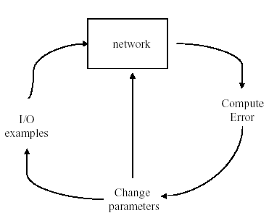
Perceptrons and Learning
perceptrons can learn from examples through a simple learning rule
calculate the error of a unit Err_{i} as the difference between the correct output T_{i} and the calculated output O_{i} Err_{i} = T_{i} - O_{i}
adjust the weight W_{j} of the input I_{j} such that the error decreases W_{ij} := W_{ij} + α *I_{ij} * Err_{ij}
α is the learning rate
this is a gradient descent search through the weight space
lead to great enthusiasm in the late 50s and early 60s until Minsky & Papert in 69 analyzed the class of representable functions and found the linear separability problem

Slide 18
Generic Neural Network Learning
basic framework for learning in neural networks
function NEURAL-NETWORK-LEARNING(examples) returns network
network := a network with randomly assigned weights
for each e in examples do
O := NEURAL-NETWORK-OUTPUT(network,e)
T := observed output values from e
update the weights in network based on e, O, and T
return network
adjust the weights until the predicted output values O
and the observed values T agree

Slide 19
Multi-Layer Networks
research in the more complex networks with more than one layer was very limited until the 1980s
learning in such networks is much more complicated
the problem is to assign the blame for an error to the respective units and their weights in a constructive way
the back-propagation learning algorithm can be used to facilitate learning in multi-layer networks

Slide 20
Diagram Multi-Layer Network
two-layer network
input units I_{k}
usually not counted as a separate layer
hidden units a_{j}
output units O_{i}
usually all nodes of one layer have weighted connections to all nodes of the next layer
O_{i}
W_{ji}
a_{j}
W_{kj}
I_{k}

Slide 21
Back-Propagation Algorithm
assigns blame to individual units in the respective layers
essentially based on the connection strength
proceeds from the output layer to the hidden layer(s)
updates the weights of the units leading to the layer
essentially performs gradient-descent search on the error surface
relatively simple since it relies only on local information from directly connected units
has convergence and efficiency problems

Slide 22
Capabilities of Multi-Layer Neural Networks
expressiveness
weaker than predicate logic
good for continuous inputs and outputs
computational efficiency
training time can be exponential in the number of inputs
depends critically on parameters like the learning rate
local minima are problematic
can be overcome by simulated annealing, at additional cost
generalization
works reasonably well for some functions (classes of problems)
no formal characterization of these functions

Slide 23
Capabilities of Multi-Layer Neural Networks (cont.)
sensitivity to noise
very tolerant
they perform nonlinear regression
transparency
neural networks are essentially black boxes
there is no explanation or trace for a particular answer
tools for the analysis of networks are very limited
some limited methods to extract rules from networks
prior knowledge
very difficult to integrate since the internal representation of the networks is not easily accessible

Slide 24
Applications
domains and tasks where neural networks are successfully used
handwriting recognition
series prediction
weather, financial forecasting
categorization
sorting of items (fruit, characters, phonemes, …)
Process Modeling and Control
Creating a neural network model for a physical plant then using that model to determine the best control settings for the plant.
Machine Diagnostics
Detect when a machine has failed so that the system can automatically shut down the machine when this occurs.
Target Recognition
Military application which uses video and/or infrared image data to determine if an enemy target is present.
Medical Diagnosis
Assisting doctors with their diagnosis by analyzing the reported symptoms and/or image data such as MRIs or X-rays.
Quality Control
Attaching a camera or sensor to the end of a production process to automatically inspect for defects.
Intelligent Searching
An internet search engine that provides the most relevant content and banner ads based on the users' past behavior.
Fraud Detection
Detect fraudulent credit card transactions and automatically decline the charge.

Slide 25
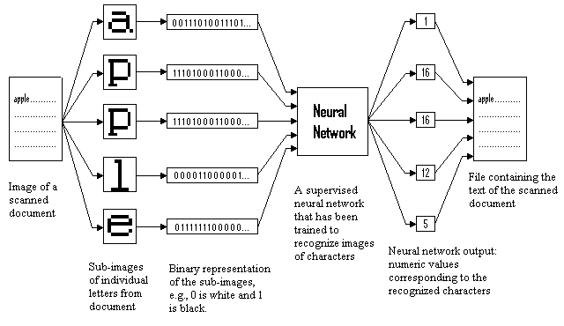
Optical Character Recognition

Slide 26
Neural Network and Business Applications
Differentiate between prospective buyers and non-buyers, drastically reducing the amount of money previously wasted pursuing non-buyers.
Distinguish between single-time buyers and multiple-time buyers so that you can market to them accordingly or use what you learn to find ways of converting single-time buyers to multiple-time buyers.
Identify people who are likely to lapse from a program so that you can use what you learn to offer them special incentive to stay.
Identify potential new markets and quickly respond to changes in the current market by being able to spot new trend.
Launch new products and services more effectively.
Identify cross-sell and up-sell opportunities.
Detect whether an event such as fraud has occurred.
Providing greater certainty in assessing risk and predicting customer behavior, which is useful for decision making.
Risk Estimation of Investment
Forecasting Currency Exchange rates

Slide 27
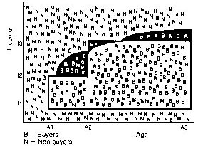
Learning Decision Tree in Data Mining

Slide 28
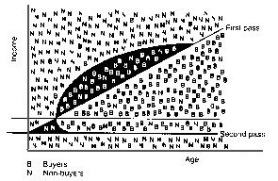
First Order Logic in Data Mining

Slide 29
Neural Network in Data Mining

Slide 30
Summary
Disadvantages of traditional learning methods
Neural Network
Fundamental Network
Advantages of Neural Network
Neural Network Applications

Slide 31
What I want you to do
Work on your assignment
Work on your term project

